Slide 1
Analyzing Credit Card Agreements
Patrick Cullinane
Project repo: https://github.com/cullinap/contract_reader

Slide 2
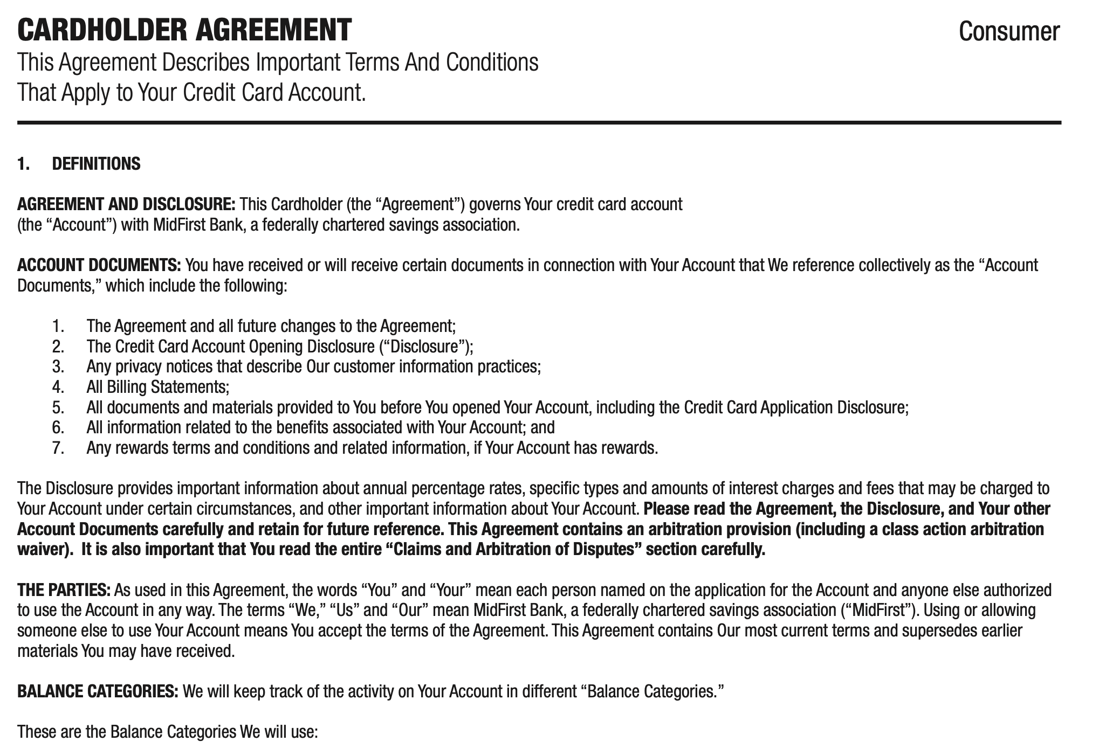
Problem Statement
For the average person legal documents are hard to read and understand.
According to one study it would take 76 days each year to read all the privacy statements you sign up for.¹
Most people do not have the time to read terms & conditions
Are there ways to apply natural language processing to group and return relevant results?
Figure 1.: Example cardholder agreement for a credit card
I/S: A Journal of Law and Policy for the Information Society, vol. 4, no. 3 (2008), 543-568.

Slide 3
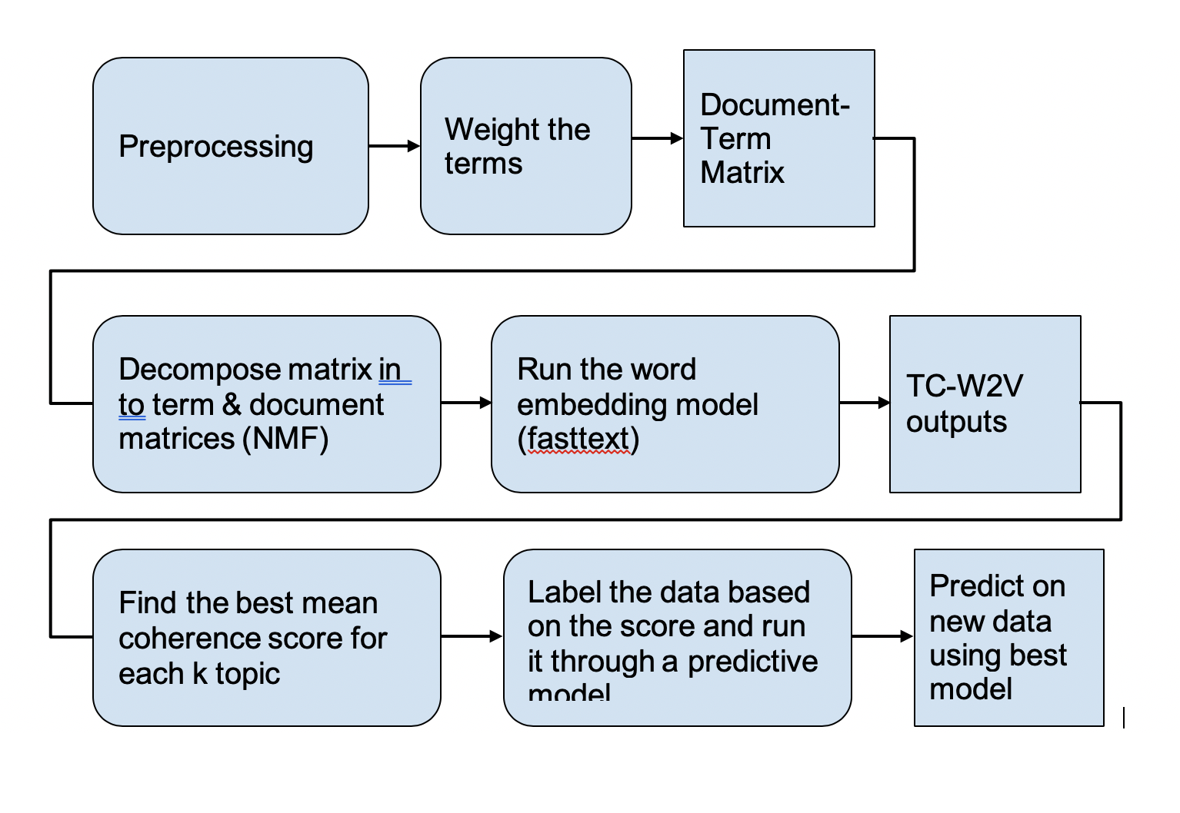
Process Overview
Credit card agreements from the Consumer Finance Protection Bureau
Convert PDF’s to text data, combine into a giant corpus, preprocess, and apply weighting algorithms.
“Break” document into “terms” & “documents”
Find the optimal number of topics (k) based on a mean topic coherence metric.
Dataset from : https://www.consumerfinance.gov/credit-cards/agreements/
Figure 2.: General overview of the process

Slide 4
Relevant Documents and Terms
After taking the text from PDFs, doing some simple preprocessing, and weighting important words we decompose the data set using a technique called non-negative matrix factorization.
We determine an optimal topic number (k)
The input is a matrix with documents on one axes and terms on the other.
The output is two matrices: terms x k and documents x k.
Figure 2.: General overview of the process

Slide 5
Determine the optimal number of topics
Run the data through a word embedding model.
Returns a score of how “close” a word will be to other words. Ex. Soviet is likely to to be found near Russia and Stalin as opposed to watermelon.
Find the top terms for each topic by comparing our NMF model v. TFIDF model for each topic
Calculates similarity score for each word pair in topic and returns the average score for each topic.

Slide 6
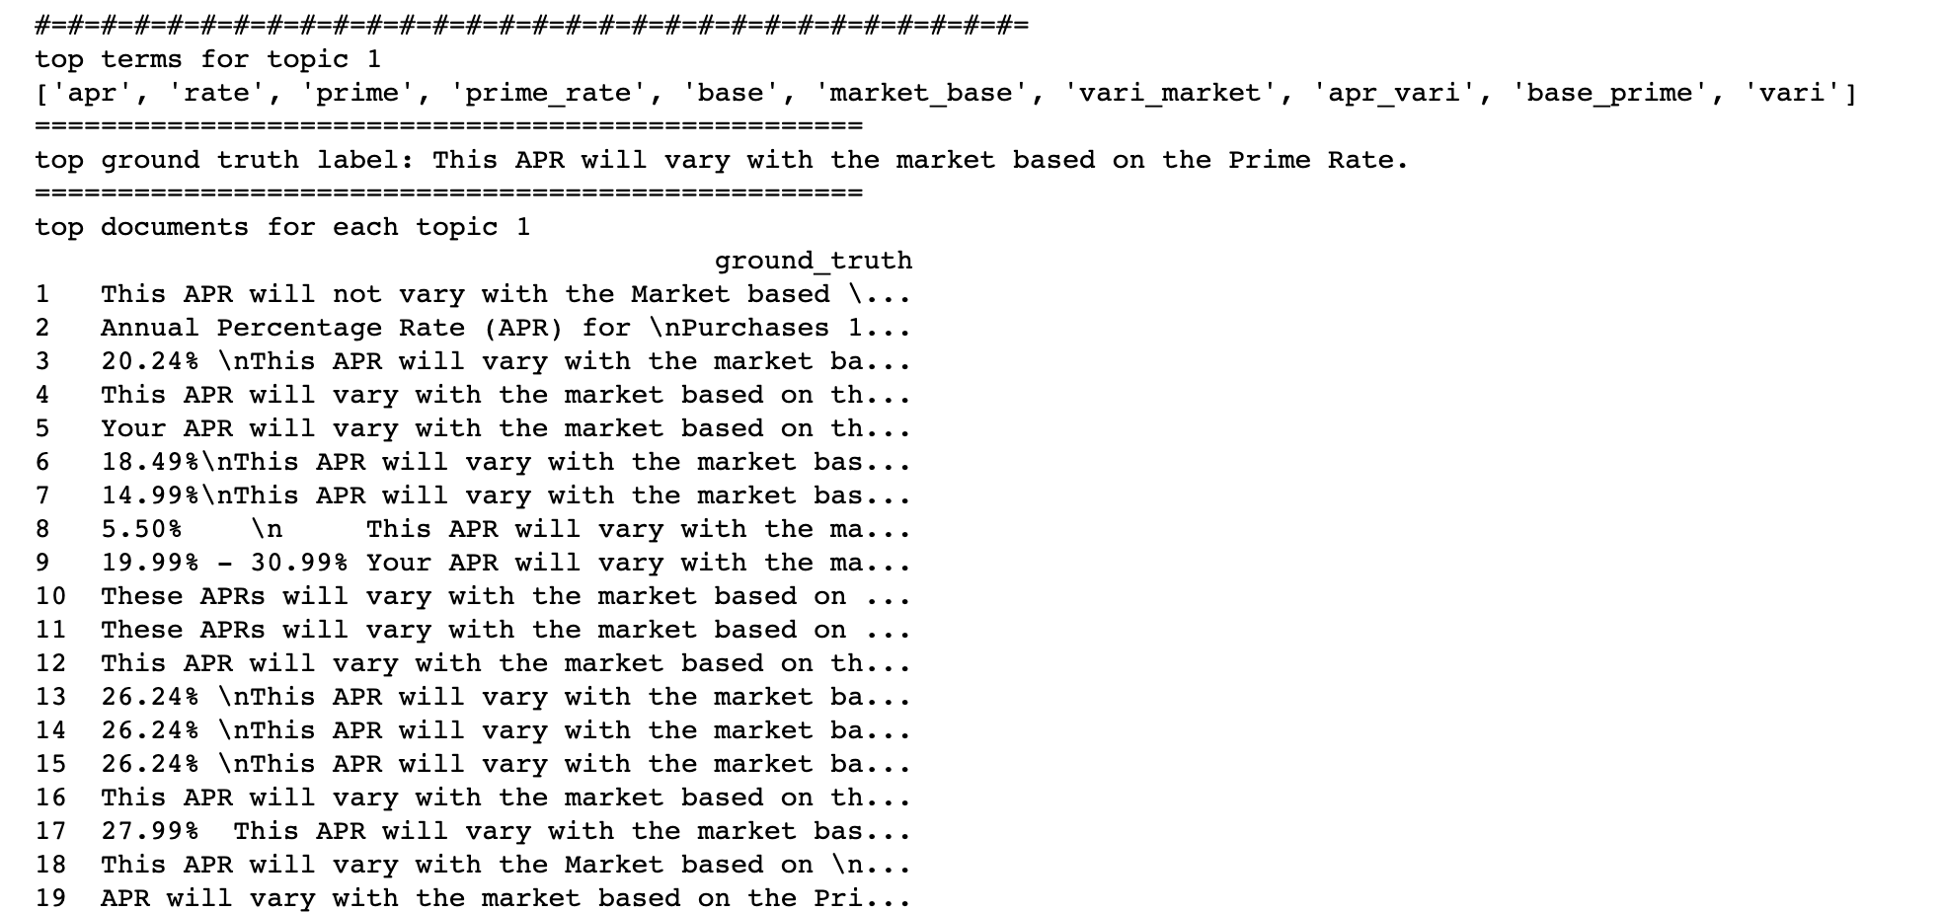
Examine the Output
Return the top terms and documents for each of our topics based on the optimal topic number.
Figure 2.: General overview of the process

Slide 7
Label the Dataset and Create a Model
Return 50 “documents” for each topic, and label them with a name.
  We chose: 'payment', 'rate', 'agreement',' error', 'fee', 'purchases', 'interest', 'credit_tips'
Run 450 examples (50x9) through a classification model.
Best performing model was Support Vector Machines.
Figure 2.: General overview of the process

Slide 8
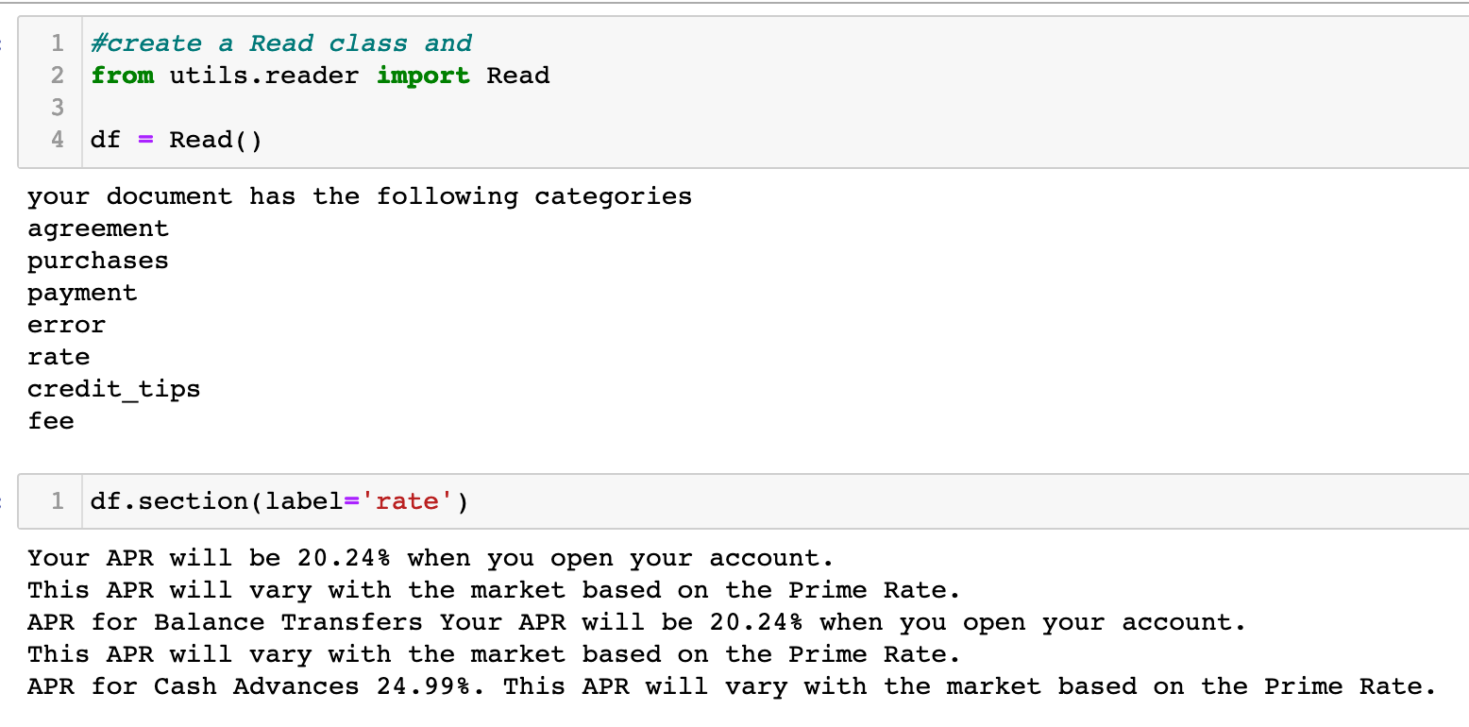
Feed a Credit Card Agreement into the Model
In this example we feed a document into our model.
  It returns the categories that it found in the document.
  The label ‘rate’ gives us the APR, when you open your account, the APR for balance transfers, and the APR for Cash Advances.
Now we know quickly that our APR will be higher if we take a cash advance. Good to know if you are shopping around for credit cards.

Slide 9
Conclusion and Future Work
It appears this model did a good job classifying snippets within the text that are labelled as credit tips, purchases, errors, and agreement.
There is some crossover between rate and interest as these categories possibly explain the same information.
The next step in this project is twofold:
  Further refine the topics to be more specific to the theme provided (i.e. adjust k value, rename labels)
  Subdivide topics further to develop more granularity on specific topics.
    For example: “Rate” subtopics can include: APR, cash advance, prime rate, etc..

